Slide 1

Binary Arithmetic (Addition; Subtraction using 2's complement)
Computer Organization and Architecture | Introduction to Digital Fundamentals
Course: Computer Organization and Architecture | Chapter: Introduction to Digital Fundamentals | Program: Bachelor of Engineering
DISCOVER · LEARN · EMPOWER
Notes:
Welcome everyone to today's lecture on Binary Arithmetic. We will focus specifically on how computers perform addition and subtraction using 2's complement. This is a fundamental skill for understanding digital logic design. Remember, our motto is Discover, Learn, and Empower.

Slide 2
Course Outcomes
SLIDE 2 / 10
Course Outcome
CO | BT LEVEL | DESCRIPTION
CO1 | BT3 | Apply number systems and digital logic to design basic digital circuits
CO2 | BT4 | Analyze register organization and instruction set architecture
CO3 | BT3 | Implement computer arithmetic algorithms and floating-point operations
CO4 | BT5 | Analyze memory hierarchy and input-output organization
CO5 | BT6 | Evaluate control unit design and pipelining performance
Chandigarh University
2 / 10
Notes:
Today's lecture directly addresses two specific course outcomes. First, we apply number systems to design basic digital circuits through arithmetic operations. Second, we evaluate control unit design by understanding how subtraction is handled efficiently in hardware.

Slide 3
Learning Objectives
SLIDE 3 / 10
Learning Outcomes
1
Analyze the rules governing binary addition and carry propagation
2
Construct the 2's complement representation for negative integers
3
Execute binary subtraction using the 2's complement method
4
Identify overflow conditions in signed binary arithmetic operations
Chandigarh University
3 / 10
Notes:
By the end of this session, you will be able to analyze binary addition rules and construct 2's complement representations. You will also execute subtraction without a dedicated subtractor circuit. Finally, you will identify when an arithmetic operation results in an overflow error.

Slide 4
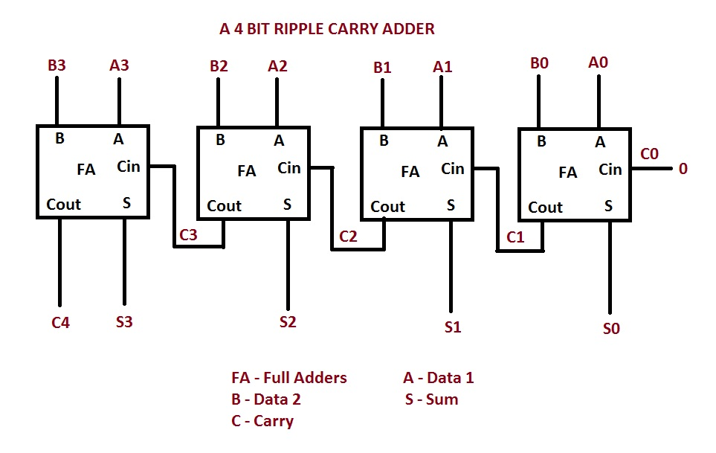
Lecture
SLIDE 4 / 10
Binary Addition Rules
GOVERNING EQUATION
0 + 0 = 0 with no carry generated to the next position
1
0 + 1 = 1 and 1 + 0 = 1 with no carry generated
2
1 + 1 = 0 with a carry of 1 to the next higher bit
3
1 + 1 + 1 = 1 with a carry of 1 to the next higher bit
4
Carry propagation moves from the least significant bit to the most significant bit
4 Bit Ripple Carry Adder | allthingsvlsi
Chandigarh University
4 / 10
Notes:
Binary addition follows simple rules similar to decimal addition but with only two digits. When you add 1 and 1, the result is 0 and you carry 1, just like 5 plus 5 equals 10. This carry propagation is critical for multi-bit addition. Let's look at a quick example: 1011 plus 0110 equals 10001.

Slide 5
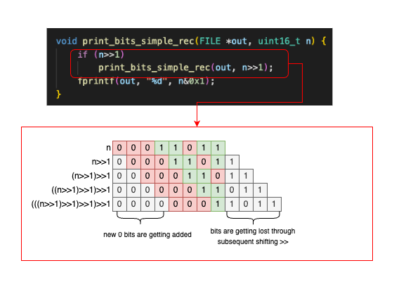
Lecture
SLIDE 5 / 10
2's Complement Concept
1
2's complement represents negative numbers in binary signed arithmetic systems
2
To find 2's complement, invert all bits of the positive number first
3
Then add 1 to the least significant bit of the inverted result
4
The most significant bit acts as the sign bit where 1 indicates negative
5
This method allows subtraction to be performed using addition hardware
Source: www.andreinc.net
Chandigarh University
5 / 10
Notes:
The 2's complement is the standard way computers store negative numbers. To convert a positive number to negative, you simply flip every bit and add one. For example, to represent -5, we start with 5, flip the bits, and add 1. This elegant method unifies addition and subtraction.

Slide 6
Lecture
SLIDE 6 / 10
Binary Subtraction Method
1
Subtraction is performed by adding the minuend to the 2's complement of the subtrahend
2
Ignore any final carry out of the most significant bit position
3
If the result has a sign bit of 1, the answer is negative
4
To find the magnitude of a negative result, take the 2's complement again
5
This method eliminates the need for separate subtraction circuitry in CPUs
Chandigarh University
6 / 10
Notes:
Instead of building complex subtractors, computers use adders for both operations. You simply take the number you are subtracting, find its 2's complement, and add it to the first number. If there is a carry out at the end, you simply discard it. This simplifies the hardware design significantly.

Slide 7
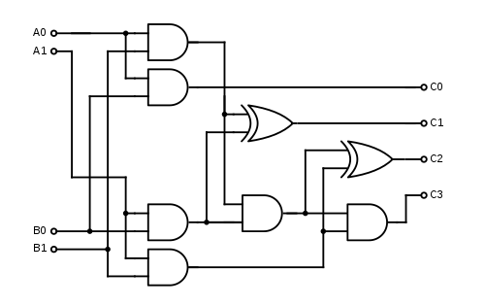
Worked Example
SLIDE 7 / 10
Subtraction
1
Calculate 7 minus 3 using 4-bit binary arithmetic
2
7 in binary is 0111 and 3 in binary is 0011
3
2's complement of 3 is 1101 obtained by inverting 0011 and adding 1
4
Adding 0111 and 1101 yields 10100, discarding the carry gives 0100
5
The result 0100 equals 4 in decimal, confirming 7 minus 3 is 4
Source: www.watelectronics.com
Chandigarh University
7 / 10
Notes:
Let's work through a concrete example: 7 minus 3. We represent 7 as 0111 and 3 as 0011. The 2's complement of 3 is 1101. When we add 0111 and 1101, we get 10100. Discarding the carry leaves 0100, which is 4. This confirms our subtraction was correct.

Slide 8
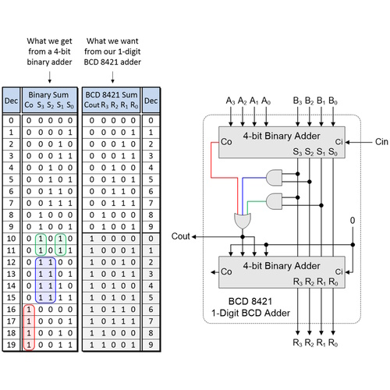
Worked Example
SLIDE 8 / 10
Negative Result
1
Calculate 3 minus 7 using 4-bit binary arithmetic
2
3 in binary is 0011 and 7 in binary is 0111
3
2's complement of 7 is 1001 obtained by inverting 0111 and adding 1
4
Adding 0011 and 1001 yields 1100 with no carry out
5
The result 1100 has a sign bit of 1, indicating a negative number
Source: www.eejournal.com
Chandigarh University
8 / 10
Notes:
Now let's try 3 minus 7. We add 0011 to the 2's complement of 7, which is 1001. The sum is 1100. Since the most significant bit is 1, the result is negative. To find the magnitude, we take the 2's complement of 1100, which gives 0100 or 4. Thus, the answer is -4.

Slide 9
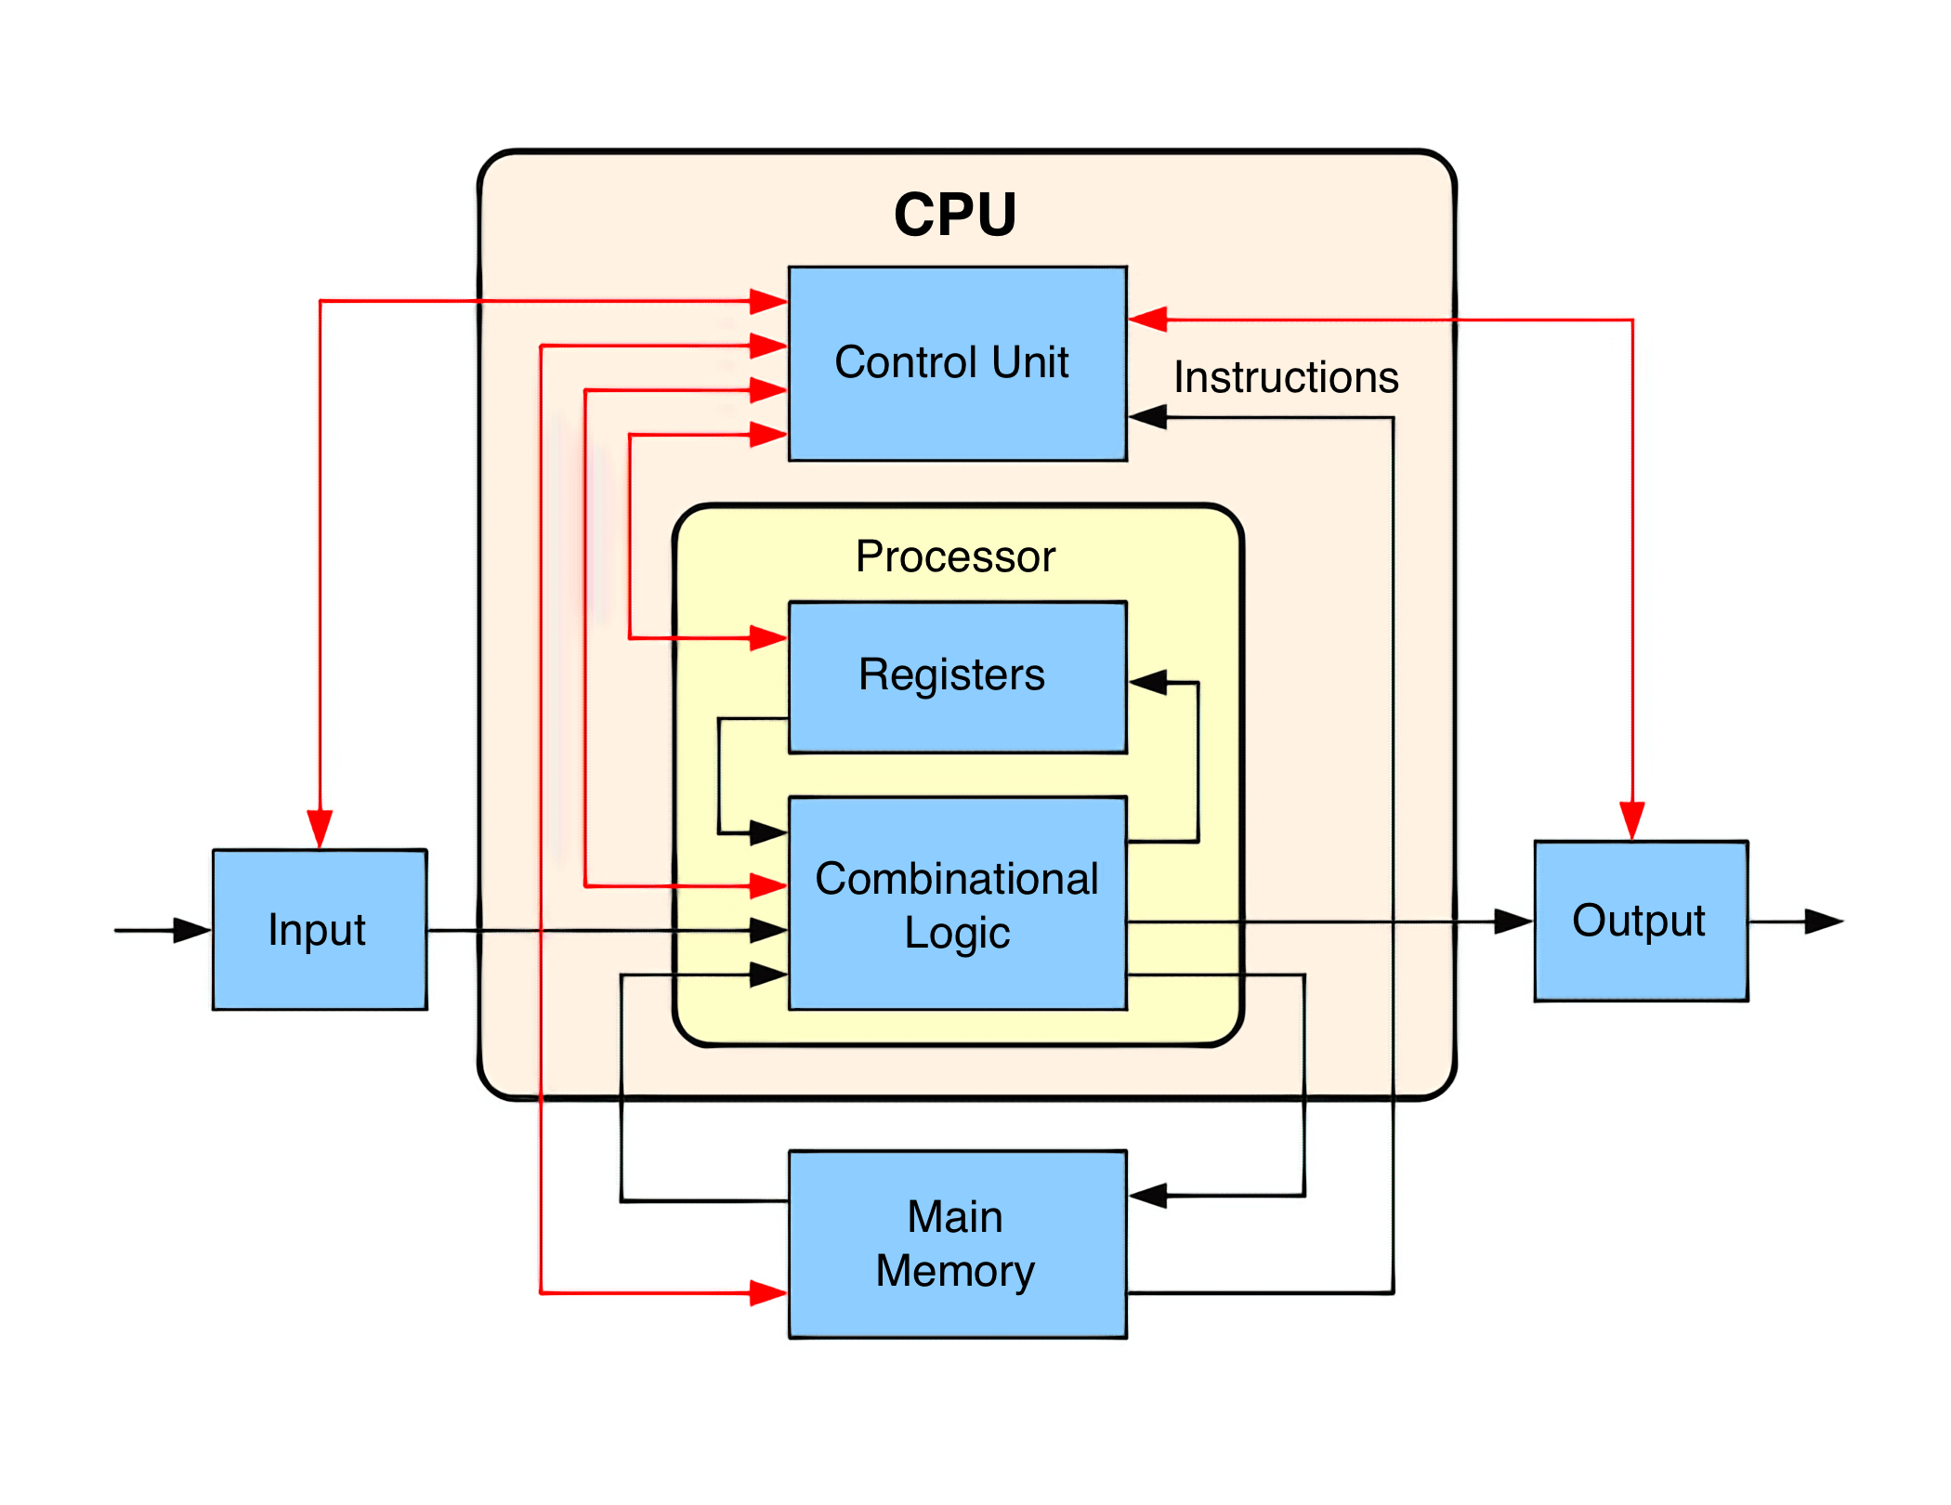
Lecture
SLIDE 9 / 10
Key Takeaways
1
Binary addition rules form the basis for all arithmetic operations in digital systems
2
2's complement allows efficient representation of negative numbers in fixed-width registers
3
Subtraction is implemented as addition of the 2's complement of the subtrahend
4
Overflow occurs when the result exceeds the range representable by the bit width
5
This unified approach simplifies CPU design by using a single adder circuit
Source: www.techspot.com
Chandigarh University
9 / 10
Notes:
To summarize, binary addition rules are fundamental to digital logic. The 2's complement method is crucial for handling negative numbers efficiently. By converting subtraction into addition, we simplify the hardware requirements for the processor. Always check for overflow when working with signed numbers.

Slide 10
Lecture
SLIDE 10 / 10
References
COMPUTER ORGANIZATION AND DESIGN
The Hardware/Software Interface — David A. Patterson, John L. Hennessy
COMPUTER ARCHITECTURE
A Quantitative Approach — John L. Hennessy, David A. Patterson
• Computer Organization and Architecture — William Stallings
• Computer System Architecture — M. Morris Mano & Rajib Mall
• Computer Organization — Carl Hamacher, Zvonko Vranesic, Safwat Zaky
Chandigarh University
10 / 10
Notes:
These five textbooks provide comprehensive coverage of the topics discussed today. I recommend Stallings and Mano for foundational concepts in digital logic and arithmetic. Patterson and Hennessy offer excellent insights into the hardware-software interface. Please refer to these texts for further study and practice problems.

